Slide 1
Tracking Billable Time in Harvest
General guidelines
Entry examples by job type

Slide 2
Required inputs:
Minimum 35 hours Billable per week
Enter all items separately – do not group multiple activities in one entry
Note “Billable” hours include all meetings, including 1:1
See next slides for input guidelines by job description

Slide 3
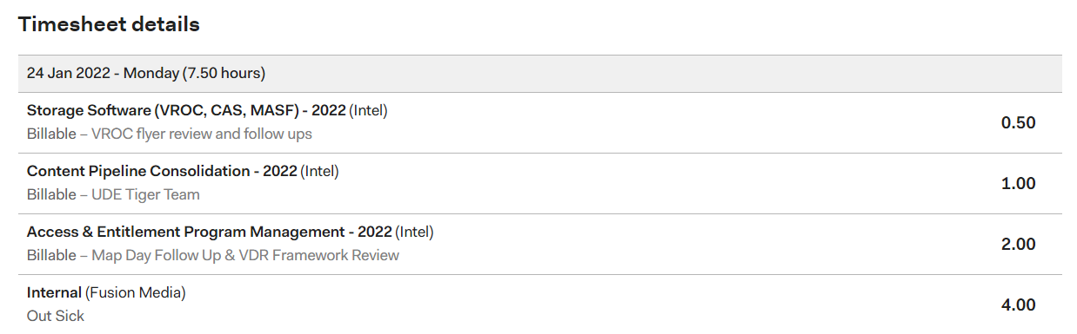
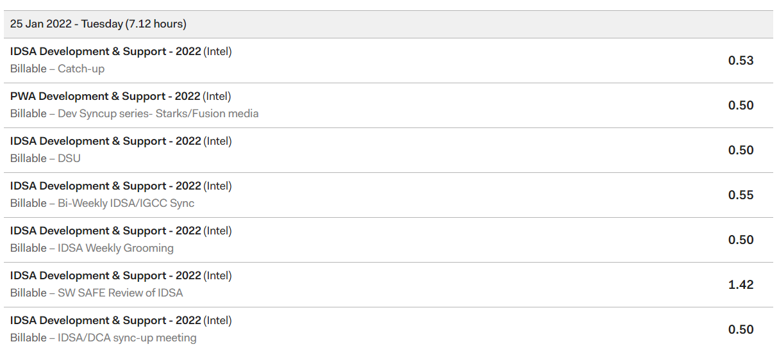
Project Manager Timesheet
Programmer Timesheet

Slide 4
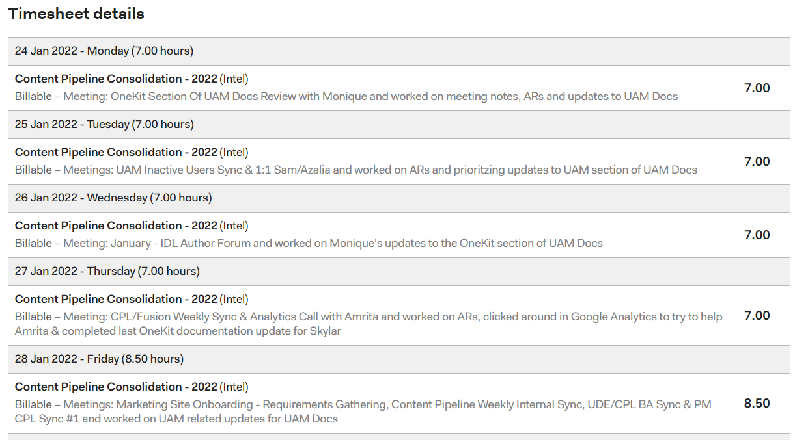
Analyst Timesheet

